Slide 1
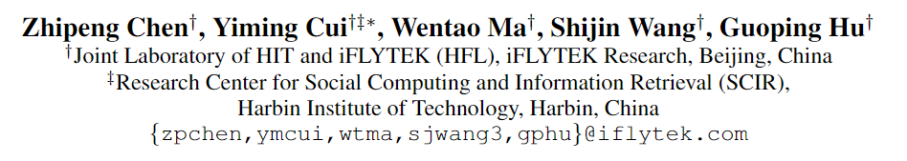
Convolutional Spatial Attention Model for Reading Comprehension with Multiple-Choice Questions
方子玄
2019/5/28

Slide 2
Introduction
Owing to the rapid release of various large-scale datasets, Machine Reading Comprehension (MRC) has become enormously popular in Natural Language Processing.
Machine Reading Comprehension (MRC) with multiple-choice questions requires the machine to read given passage and select the correct answer among several candidates.

Slide 3
Challenges
At the be-ginning of the reading comprehension study, this type of reading comprehension task was not that popular because there is no large-scale dataset available and thus we cannot apply neural network approaches to solve them.
To bring more challenges to reading comprehension task and miti-gate the absence of large-scale multi-choice reading comprehension dataset, Lai et al.(2017) propose a new dataset called RACE.

Slide 4
the RACE dataset is made from the English examinations for Chinese middle and high school students, consisting near 100,000 questions generated by human experts, and is far more challenging than the MCTest.
Different from the earlier MCTest dataset (Richardson, Burges, and Ren-shaw 2013), the RACE dataset is significantly larger, and thus we can apply deep learning approaches for this task.
As all the questions and choices are generated by human experts, RACE dataset provides more comprehensive and realistic evaluation on machine reading comprehension than the other popular datasets such as CNN/DailyMail, SQuAD datasets, whose answer should appear in context.

Slide 5
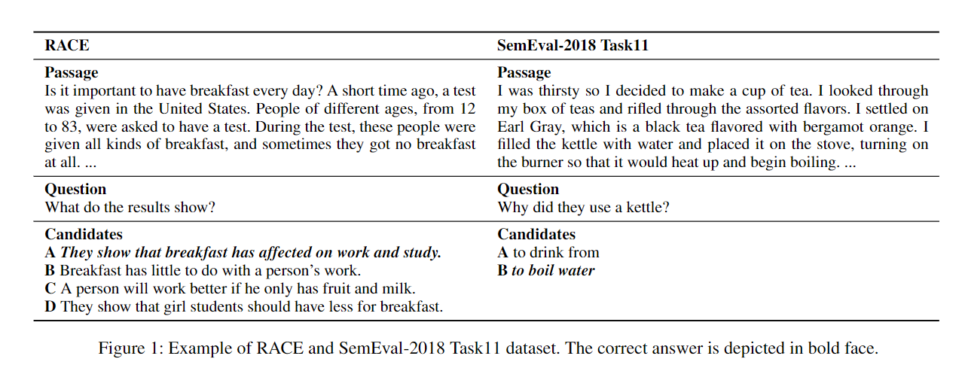
2018 Task11 is closely the same with the RACE dataset but with two candidates and small size.

Slide 6
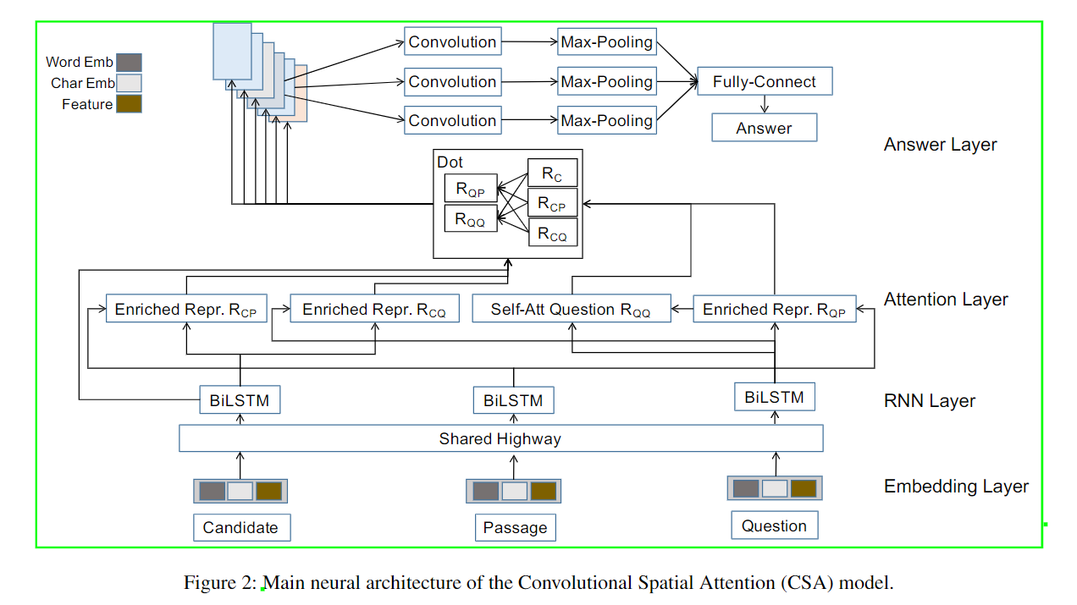
The Model

Slide 7

Word Representation
We transform each word in the passage, question, and candidates into continuous representations. In this paper, there are three components in the embedding layer, which can be listed as follows:
Word Embedding Eword: We use traditional pretrained GloVe embedding for initialization (Pennington, Socher, and Manning 2014) and keep fixed during the training process.
ELMo Embedding Eelmo: For this part, we use pre-trained ELMo (Peters et al. 2018) embedding.
Feature Embedding Efeat: We also utilize three addi-tional features to enhance the word representations: POS-tag Embedding Epos, Word Matching Fmatch, Fuzzy Word Matching Ffuzzy.

Slide 8

After obtaining embedding representations, we further feed each word embedding into a shared highway network (Srivastava, Greff, and Schmidhuber 2015) with tanh output activation.
Then we use Bi-Directional LSTM (Graves and Schmidhuber 2005) to model the contextual information.

Slide 9
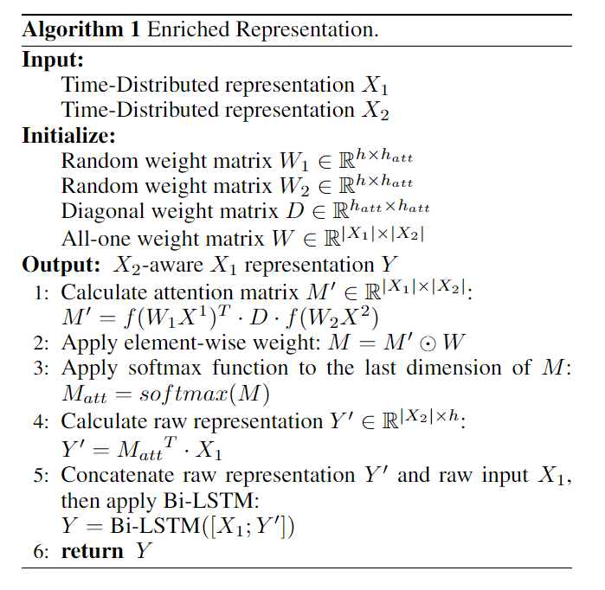
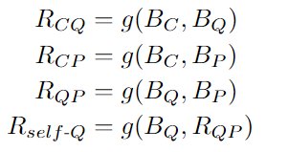
Enriched Representation
Calculating attention and generating enriched representation play very important roles in machine reading.
For example, we wish to embed the passage information into the candidate representation to better aware the relevant part in the passage and obtain the passage-aware candidate representation RCP.

Slide 10
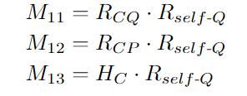
Convolutional Spatial Attention
With previously generated representations, we can calculate the matching matrix to measure the similarity between them.
As the candidate information is important to answer the question, firstly we calculate the matching matrix using various candidate representations to the self-attended question representation Rself-Q.
In a similar way, we can also replace the self-attended question representation Rself-Q with passage-aware question representation RQP to obtain M21;M22;M23.

Slide 11
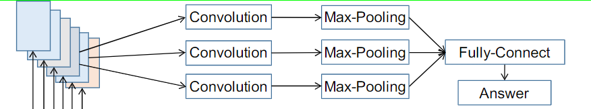
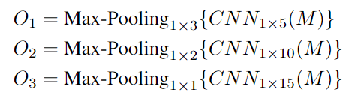

Slide 12

Final Prediction
After obtaining three feature vectors, we flatten, concatenate, and feed them into a fully-connected layer to get a scalar value denoting the possibility of being the correct answer.
We apply softmax function to these scores to obtain the final probability distributions over the candidates.

Slide 13
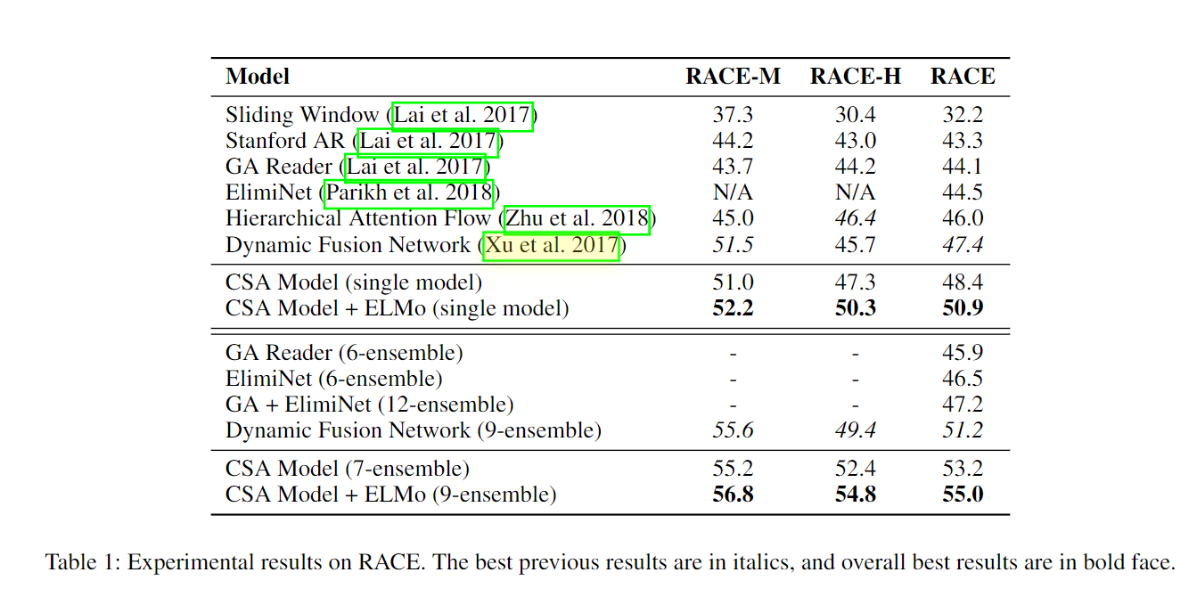
EXPERIMENTS

Slide 14
Thanks!

